Slide 1
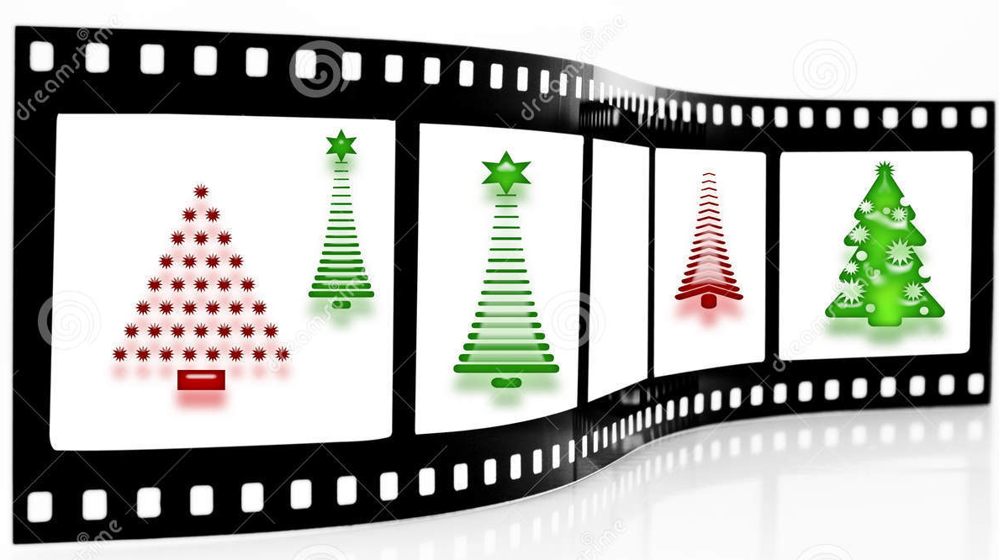
Student Work-Techniques
Holiday Movie Trailers

Slide 2
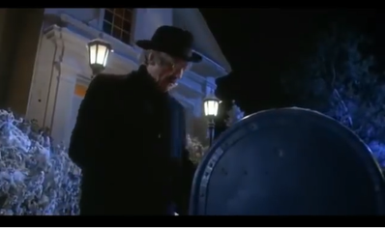
GREMLINS

Slide 3
This low angle shot signifies how there is something unknown in the box and the shot is low to show the man’s curiosity and fear as he looks inside the mailbox to find a gremlin.

Slide 4
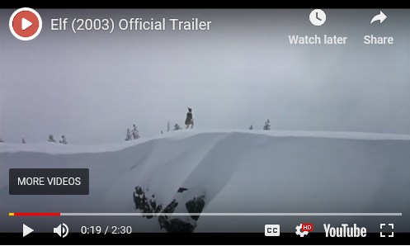
Elf

Slide 5
Long Shot/ Establishing Shot: In this photo, you can see that Buddy has a very long, grueling trip ahead of him, to get to New York. His goal is to find and be with his father.

Slide 6
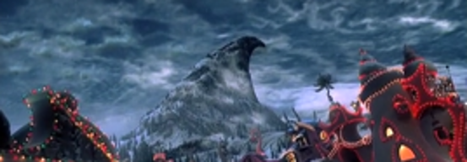
How the Grinch Stole Christmas

Slide 7
This shot is from the movie, "How The Grinch Stole Christmas".​
The low angle view in the picture makes the mountain, where the Grinch lives, look powerful and threatening. It gives the Grinch power because it paints him a menacing figure who towers over the town.

Slide 8
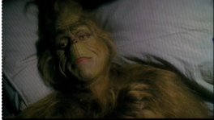
How the Grinch Stole Christmas

Slide 9
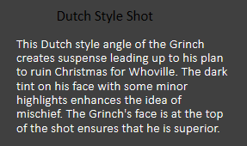

Slide 10
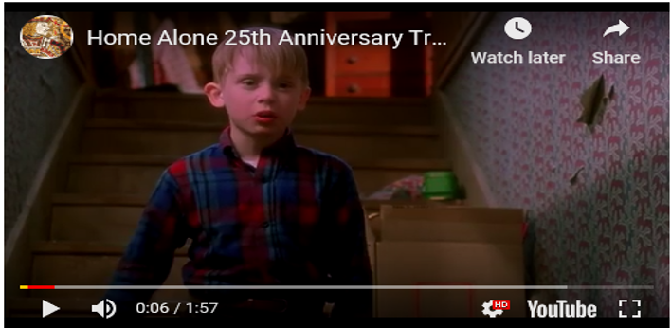
Home Alone

Slide 11
This is a low angle shot. It shows the moms perspective from the bottom of the stairs. The use of this shot depicts how Kevin is looking down on his family because of how he is treated. He thinks he would be better off without them.

Slide 12
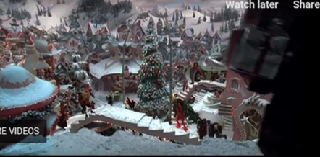
How the Grinch Stole Christmas

Slide 13
This long shot establishes the area and shows a big overview of the city. It shows how the town is decorated with a lot of Christmas decorations which makes the Grinch angry.

Slide 14
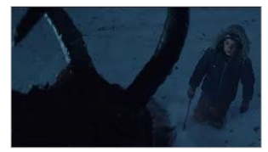
Krampus

Slide 16
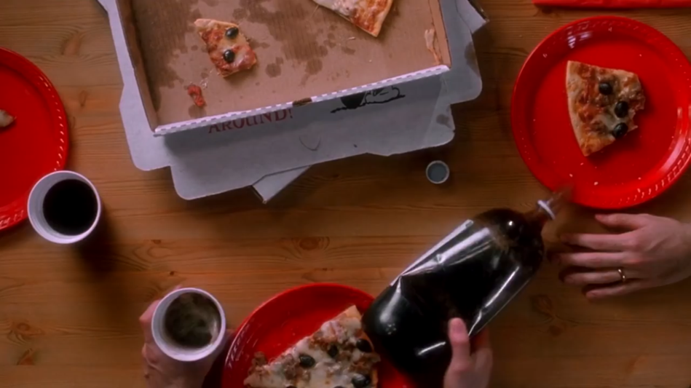
Home Alone

Slide 17
Birds Eye Shot (aka: Extreme High Angle)- Shows how hectic the family gathering is and how unorganized they are. Foreshadows how they’re ignorant and possibly forget things easily

Slide 18
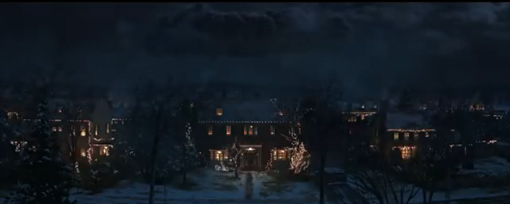
Krampus

Slide 19
Shows the house where everyone is and how there is a dark cloud overhead. This represents the fact that danger is coming/a supernatural force is making it’s way to the family.

